Slide 1

Chapter 12
Multiple Access
Copyright © The McGraw-Hill Companies, Inc. Permission required for reproduction or display.

Slide 2
Link Layer and LANs
understand principles behind link layer services:
error detection, correction
sharing a broadcast channel: multiple access
Framing - link layer addressing
local area networks: Ethernet

Slide 3
Link Layer Terminology
Nodes : hosts and routers
Links:
wired links
wireless links
Frame : layer-2 packet
data-link layer has responsibility of
transferring datagram from one node
to physically adjacent node over a link

Slide 4
Link layer services
Framing
encapsulate datagram into frame, adding header, trailer
“MAC” addresses used in frame headers to identify source, destination
different from IP address!
Link access:
channel access if shared medium
Reliable delivery between adjacent nodes
we learned how to do this already (Transport Layer)
seldom used on low bit-error link (fiber, some twisted pair)
wireless links: high error rates
Q: why both link-level and end-end reliability?

Slide 5
Link layer services (more)
error detection:
errors caused by signal attenuation, noise.
receiver detects presence of errors:
signals sender for retransmission or drops frame
error correction:
receiver identifies and corrects bit error(s) without resorting to retransmission
flow control:
pacing between adjacent sending and receiving nodes
half-duplex and full-duplex
with half duplex, nodes at both ends of link can transmit, but not at same time

Slide 6
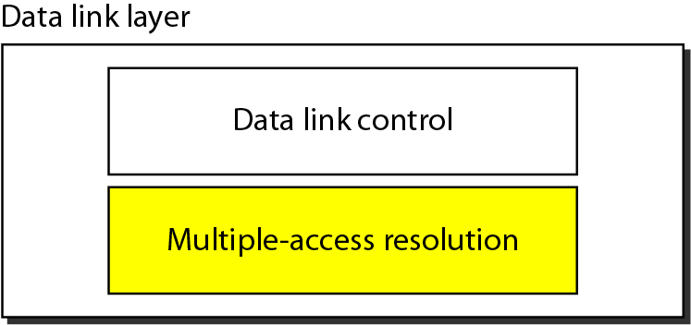
Figure 12.1 Data link layer divided into two functionality-oriented sublayers

Slide 7
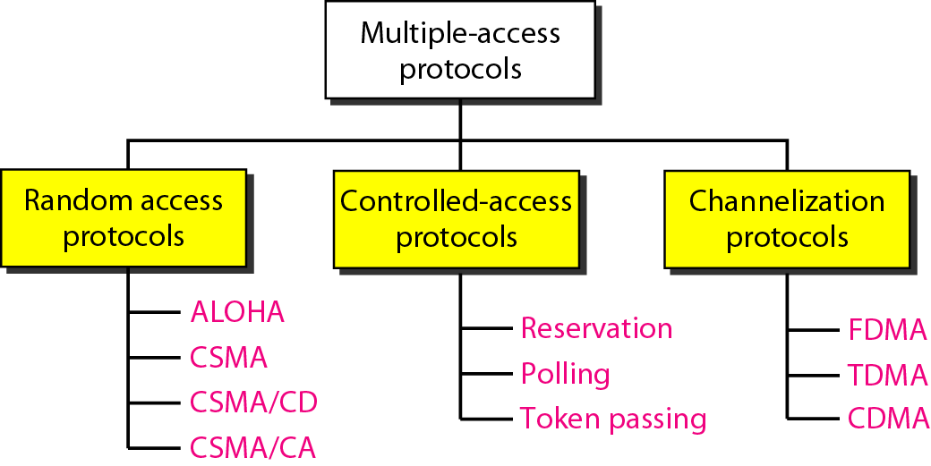
Figure 12.2 Taxonomy of multiple-access protocols discussed in this chapter

Slide 8
12-1 RANDOM ACCESS
In random access or contention methods, no station is superior to another station and none is assigned the control over another. No station permits, or does not permit, another station to send. At each instance, a station that has data to send uses a procedure defined by the protocol to make a decision on whether or not to send.
Topics discussed in this section:
ALOHA Carrier Sense Multiple Access
Carrier Sense Multiple Access with Collision Detection
Carrier Sense Multiple Access with Collision Avoidance

Slide 9
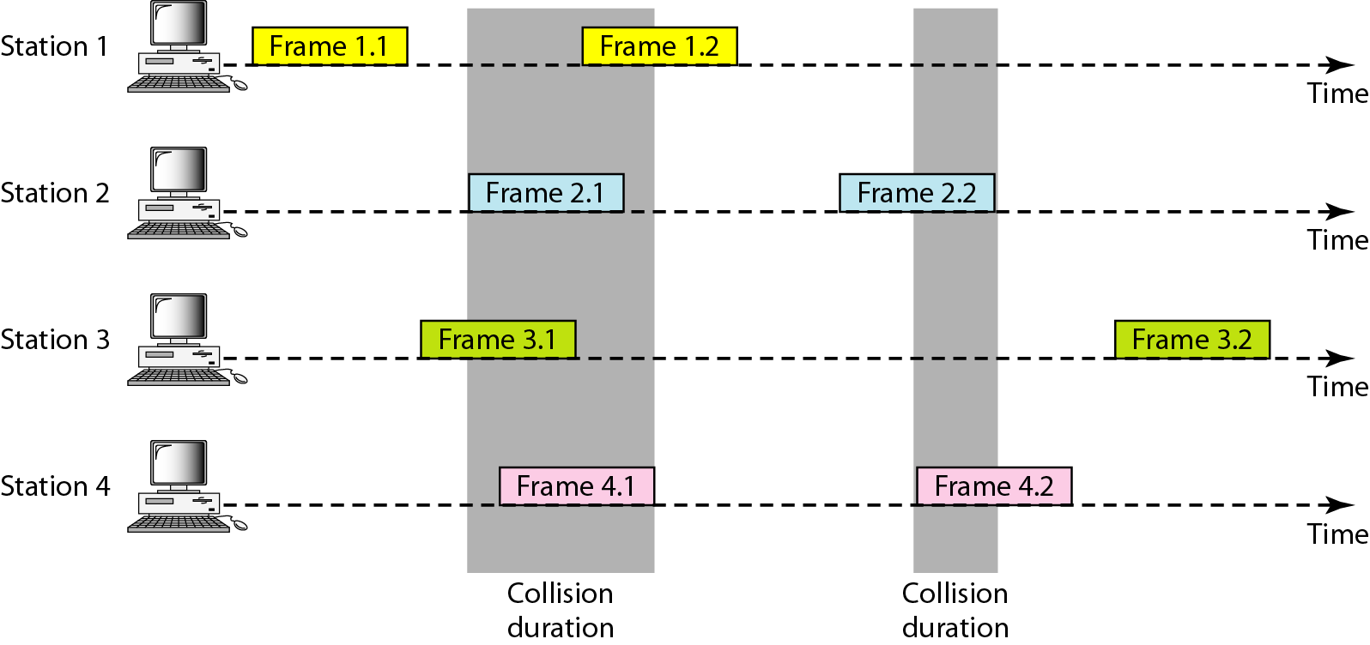
Figure 12.3 Frames in a pure ALOHA network

Slide 10
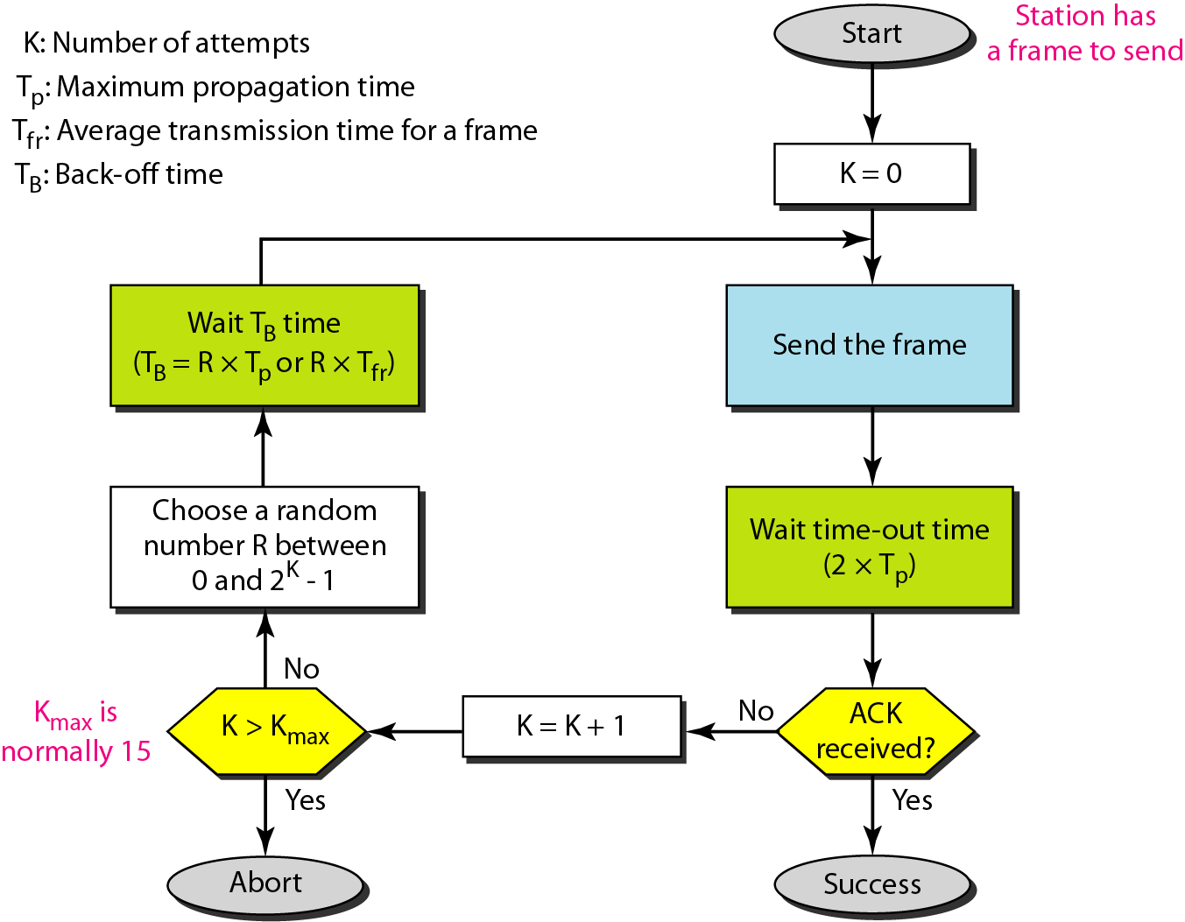
Figure 12.4 Procedure for pure ALOHA protocol

Slide 11
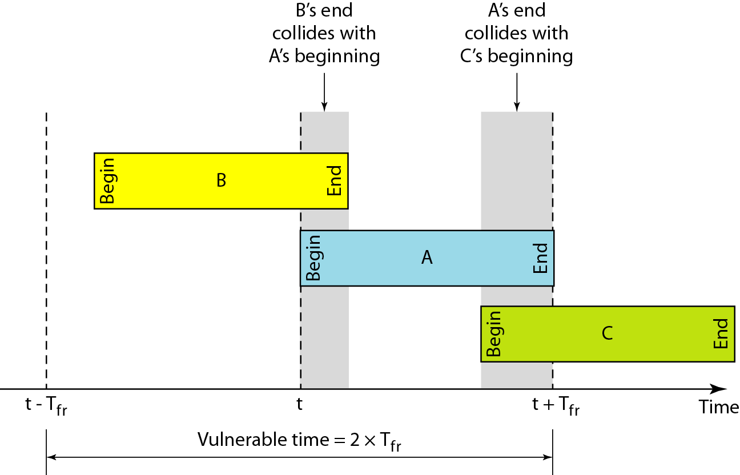
Figure 12.5 Vulnerable time for pure ALOHA protocol

Slide 12
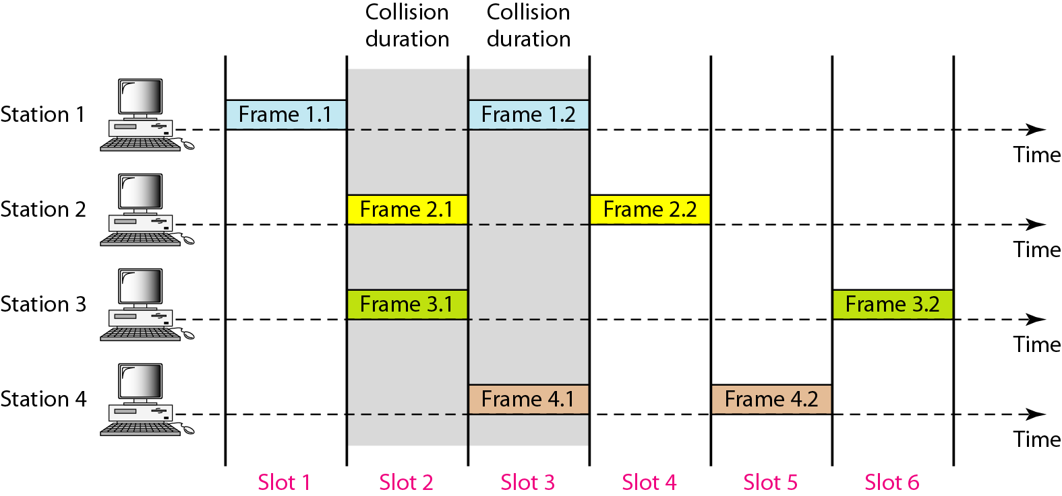
Figure 12.6 Frames in a slotted ALOHA network

Slide 13
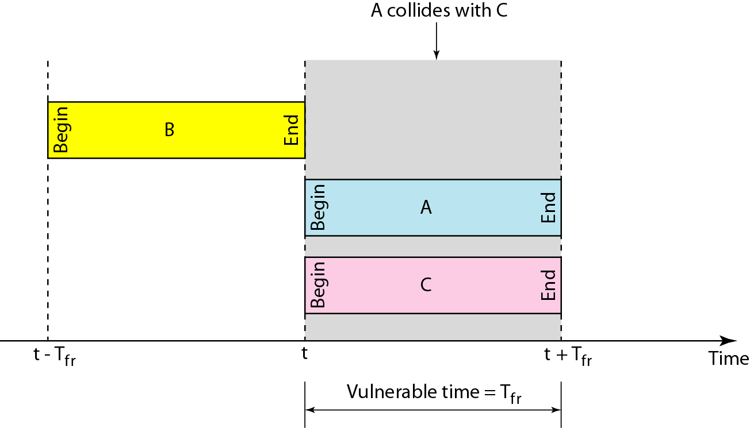
Figure 12.7 Vulnerable time for slotted ALOHA protocol

Slide 14
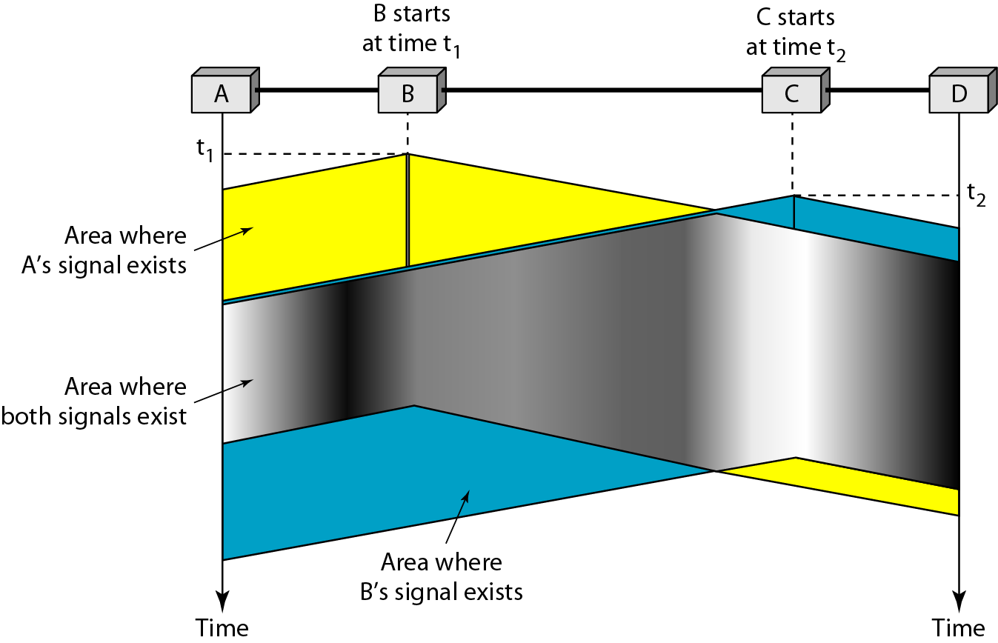
Figure 12.8 Space/time model of the collision in CSMA

Slide 15
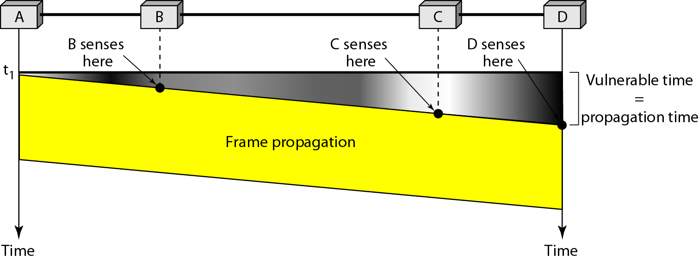
Figure 12.9 Vulnerable time in CSMA

Slide 16
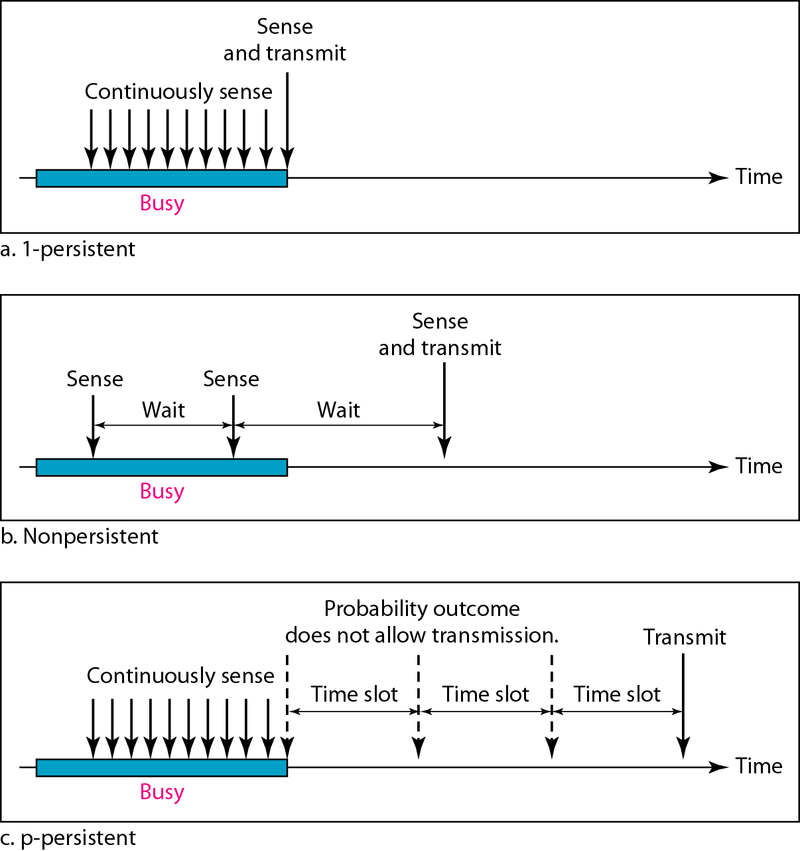
Figure 12.10 Behavior of three persistence methods

Slide 17
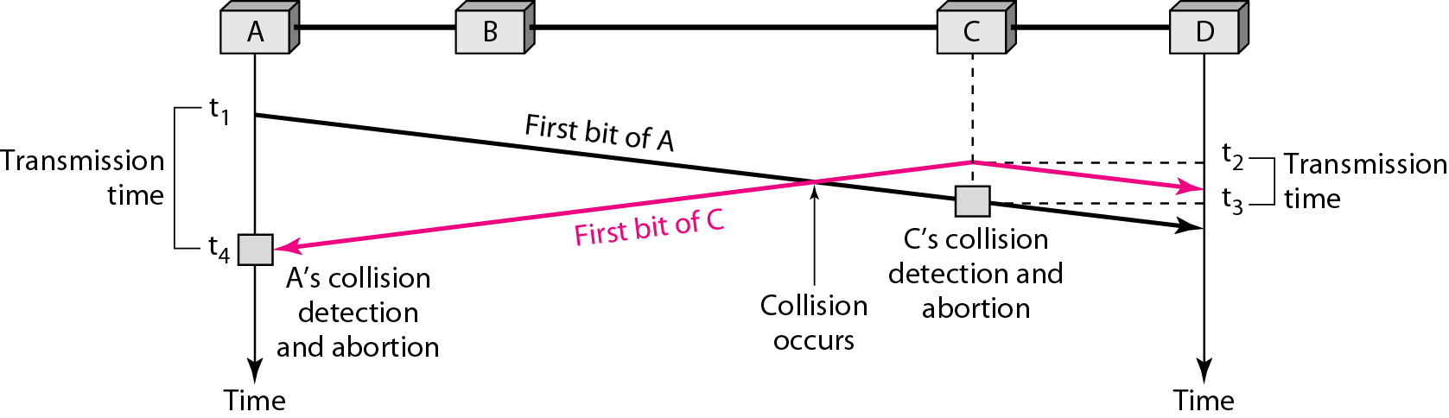
Figure 12.12 Collision of the first bit in CSMA/CD

Slide 18
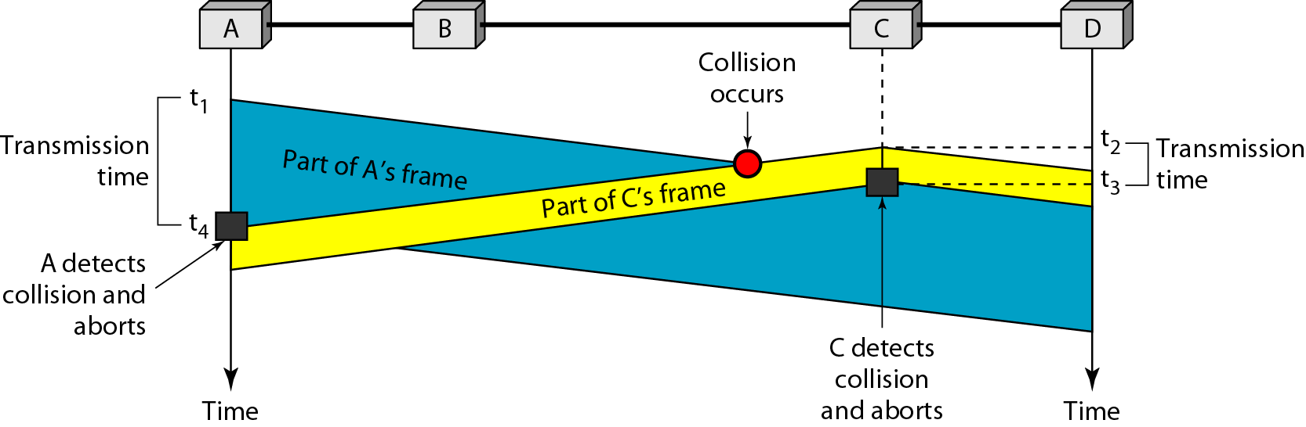
Figure 12.13 Collision and abortion in CSMA/CD

Slide 19
Example 12.5
A network using CSMA/CD has a bandwidth of 10 Mbps. If the maximum propagation time (including the delays in the devices and ignoring the time needed to send a jamming signal, as we see later) is 25.6 μs, what is the minimum size of the frame?
Solution
The frame transmission time is T_{fr} = 2 × T_{p} = 51.2 μs. This means, in the worst case, a station needs to transmit for a period of 51.2 μs to detect the collision. The minimum size of the frame is 10 Mbps × 51.2 μs = 512 bits or 64 bytes. This is actually the minimum size of the frame for Standard Ethernet.

Slide 20
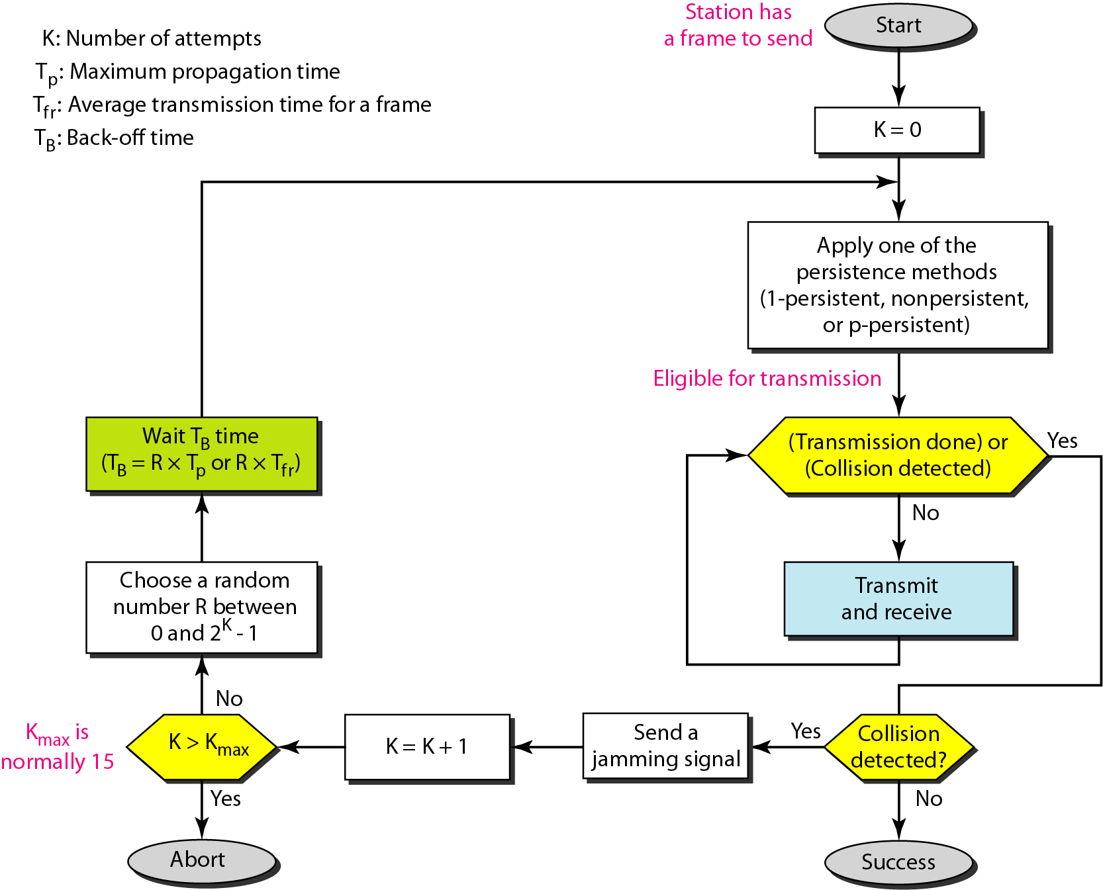
Figure 12.14 Flow diagram for the CSMA/CD

Slide 21
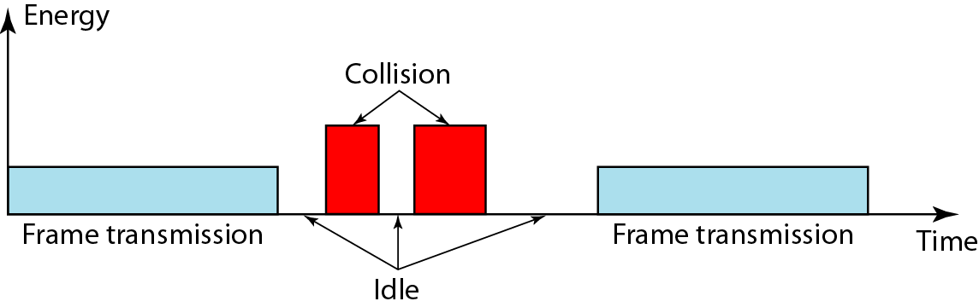
Figure 12.15 Energy level during transmission, idleness, or collision

Slide 22
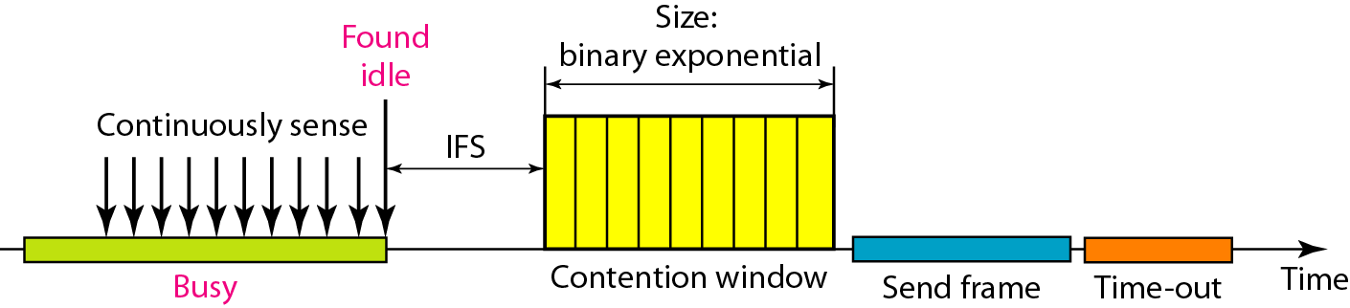
Figure 12.16 Timing in CSMA/CA

Slide 23

Note
In CSMA/CA, the IFS can also be used to define the priority of a station or a frame.

Slide 24
Note
In CSMA/CA, if the station finds the channel busy, it does not restart the timer of the contention window;
it stops the timer and restarts it when the channel becomes idle.

Slide 25
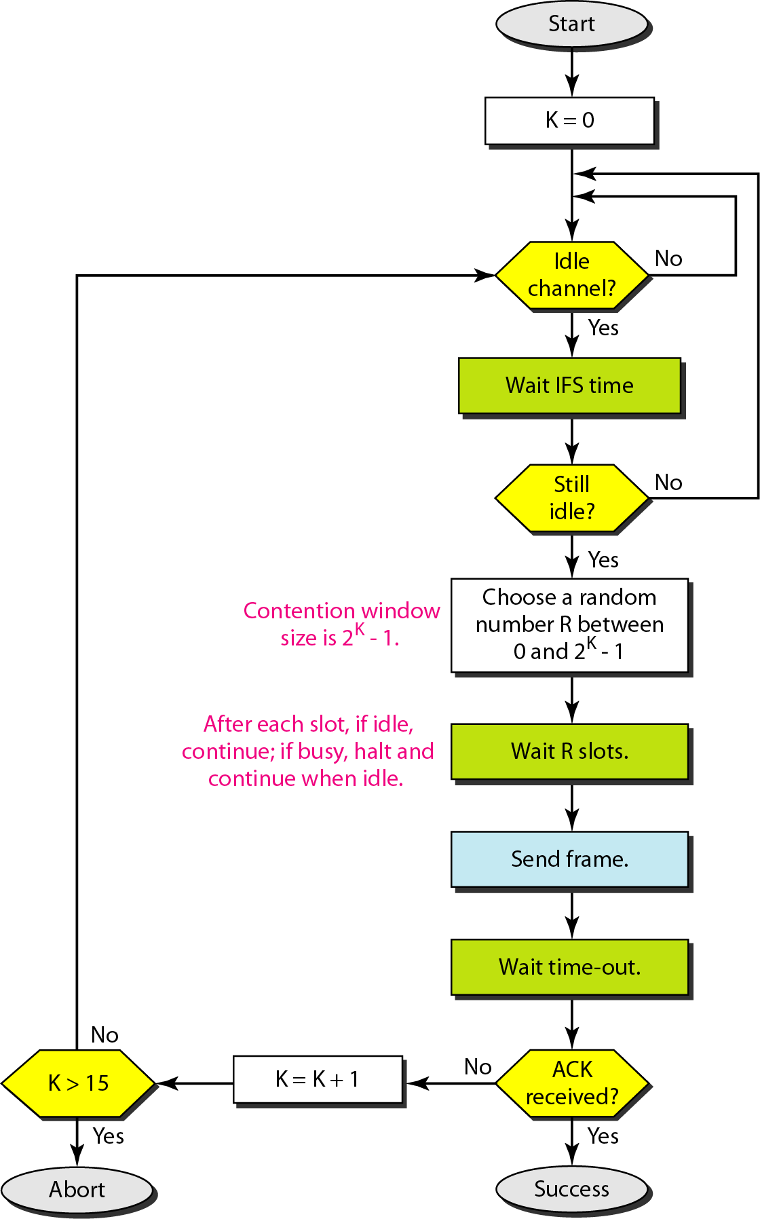
Figure 12.17 Flow diagram for CSMA/CA

Slide 26
Channel Partitioning MAC Protocols
Time Division Multiple Access
Frequency Division Multiple Access
Code Division Multiple Access

Slide 27
TDMA: Time Division Multiple Access
TDMA divides divides the time frames into time slots.
Each slot is assigned to one of the nodes.
Slots sizes are usually the same as the packet (frame) size of node.
Advantages
Eliminates collision
Each node gets dedicated R/N bps during frame time.
Frequency

Slide 28
Channel partitioning MAC protocols: TDMA
Disadvantages:
Unused slots go idle
Example: 6-station LAN, 1,3,4 have packets to send, slots 2,5,6 idle
When there is only one node to transmit
Then the node is limited to an average rate of R/N bps
The node must wait for it’s turn to transmit
6-slot
frame
6-slot
frame
1
3
4
1
3
4

Slide 29
FDMA: Frequency Division Multiple Access
channel spectrum divided into frequency bands
each station assigned fixed frequency band
Disadvantage
unused transmission time in frequency bands go idle
example: only band 1 have packet to send, frequency bands 2 & 3 remains idle
Limited bandwidth of R/N for each node
Frequency
f3
f2
f1
Time

Slide 30
CDMA: Code Division Multiple Access
Assigns a different code to each node.
Each node then uses its unique code to encode the data bits it sends.
Disadvantage
Total frequency band is used inefficiently.

Slide 31
MAC protocols
MAC Protocols
Channel Partitioning
Random Access
Taking Turns
Efficient and fair at High load
Inefficient at low load
Efficient at Low Load
Inefficient at high load
Best of both worlds?

Slide 32

“Taking turns” MAC protocols
Polling:
master node “invites” slave nodes to transmit in turn
typically used with “dumb” slave devices
Concerns:
polling overhead
latency
single point of failure (master)
data
poll
master
data
slaves

Slide 33
“Taking turns” MAC protocols
T
Token passing:
token message
control token passed from one node to next sequentially.
Concerns:
token overhead
latency
single point of failure (token)
(nothing
to send)
T
data

Slide 34
Summary of MAC protocols
channel partitioning, by time, frequency or code
Time Division, Frequency Division
random access (dynamic),
ALOHA, S-ALOHA, CSMA, CSMA/CD
carrier sensing: easy in some technologies (wire), hard in others (wireless)
CSMA/CD used in Ethernet
CSMA/CA used in 802.11
taking turns
polling from central site, token passing
Bluetooth, FDDI, token ring

Slide 35
THE END!

